Slide 1

Prediction of Diabetes using Data Mining Techniques
CS6220 Data Mining Techniques - Final Project
Team Members: Paul Cruz, Chih-Ming Sun, Haocheng Yang

Slide 2
Introduction
Diabetes is a well-known disease affecting individuals all over the world.
According to the WHO (World Health Association), an estimated 422 million people worldwide currently have diabetes with the majority living in low-and middle-income countries.
In addition, 1.6 million deaths are directly attributed to diabetes each year.
Can diabetes be prevented?

Slide 3
Introduction
Recent research utilizing data science via data mining techniques including predictive modeling using machine learning is inspiring confidence in the medical world. (Huang, 2021)
Though there are many factors that may contribute to a diabetes diagnosis, such as heredity, weight, and height, the major factor is blood sugar concentration.
The early identification of abnormal glucose levels may be the only remedy to further complications and therefore a more serious diagnosis.
Thus, analysis of the levels of sugar in the blood and how it may compare to other compounds measured is paramount in predictive modeling.

Slide 4
Introduction
We focus on over 70 datasets recorded on patients with diabetes ranging from several weeks to several months, containing readings of glucose, insulin, and patient lifestyle data.
Decision Tree machine learning classification algorithms are used and evaluated on the University of Irvine dataset with the aim to predict diabetes in a patient.
Therefore, experimental performance of many of the most commonly used predictive modelling algorithms and methods will be employed with the intent to solve this problem.

Slide 5
Methodology - Dataset
The dataset used for this study was provided by Kaggle, a data repository website.
This dataset was provided to the repository courtesy of the University of California, Irvine (UCI), and included 70 sets of data recorded on diabetes patients ranging from several weeks to several months’ worth of glucose, insulin, and lifestyle data per patient, as well as a description of the problem domain.
The dataset included the following tables: Pregnancies, Glucose, Blood Pressure, Skin Thickness, Insulin, BMI, Diabetes Pedigree Function, Age, and Outcome.

Slide 6
Methodology - Data Processing
The data was first viewed to allow for proper analysis of its standard distribution. The data was then pre-processed to correct data inconsistencies, missing values, and to remove null values.

Slide 7
Methodology - Data Analysis
We first created a heatmap to understand the correlation coefficient of the features of the data.
Next, we chose to plot a histogram to analyze the association between outcome and diagnosis.
We then chose to evaluate the following models by splitting the data into 70% training, and 30% test: Decision Tree, Support Vector Machine (SVC), K Neighbors Classifier (KNN), Gradient Boosting Classifier, Random Forrest Classifier, Ada Boost, Gaussian NB, and Gradient Boosting.

Slide 8
Methodology - Data Analysis
A cross validation accuracy score was assessed.
We then trained the machine learning models and evaluated the accuracy of each model.
Three models were chosen to move forward with the analysis, in which a confusion matrix and ROC curve was plotted and analyzed.
After analyzing feature importance and accuracy scores, two features were found to have significance.

Slide 9
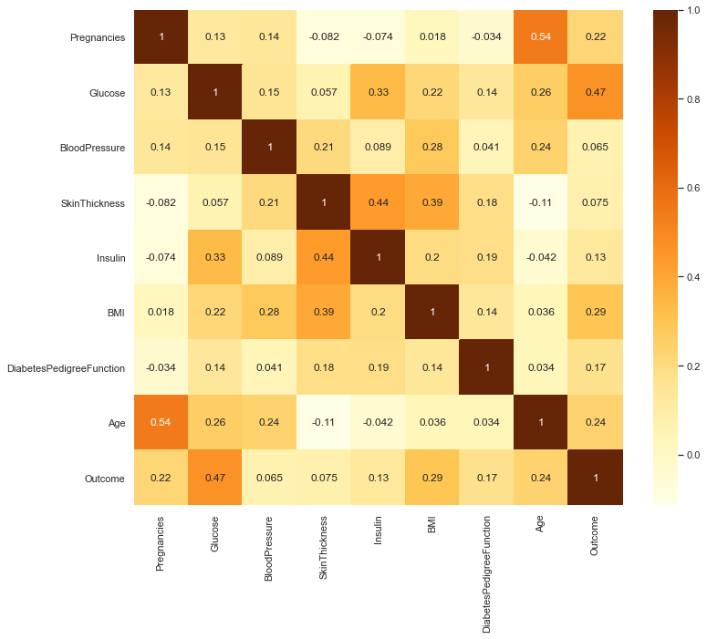
RESULT
First, we created a heatmap to understand the correlation coefficient of the features of the data.
We analyzed the value of the correlation coefficient, which can be between -1 to +1, respectively.
A score of 1 indicates that the features are highly correlated, while a score of 0 means there is no correlation.
The heatmap clearly showed correlation between each feature attribute.

Slide 10
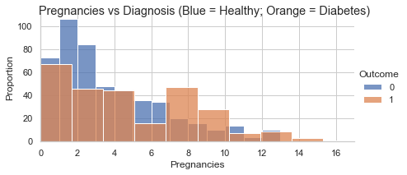
RESULT
Preganancy vs diagnosis showed that an around half of pregnancys resulted in an outcome of a women getting diabetes.

Slide 11
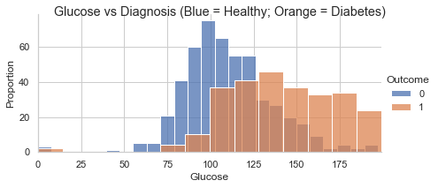
RESULT
Glucose vs diagnosis showed that glucose levels over 76 and mainly above 125 was correlated with diabetes diagnosis.

Slide 12
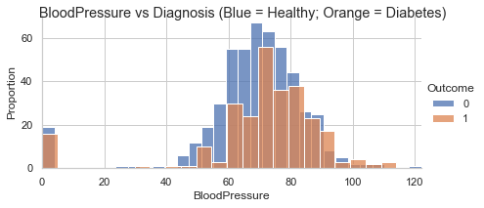
RESULT
Blood pressure vs diagnosis showed that both healthy and diabetic individuals have around the same blood pressure, o significance.

Slide 13
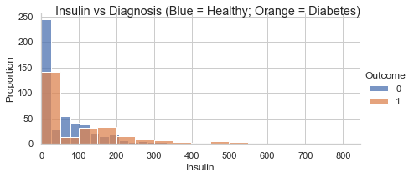
RESULT
Insulin vs diagnosis found the same, that health and diabetic patients exhibited similar insulin levels.

Slide 14
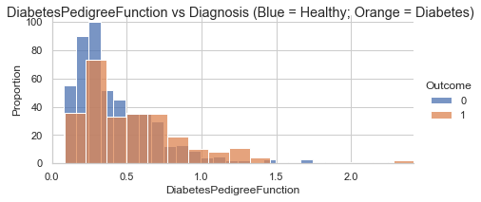
RESULT
Diabetes Pedigree Function vs diagnosis showed that around half the proportion exhibited diabetes.

Slide 15
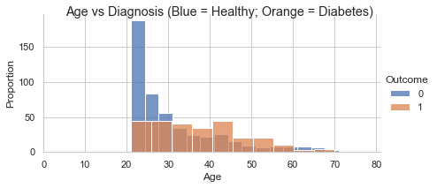
RESULT
Age vs diagnosis showed that diabetes in this dataset is found between he gaes of 22-70 years old.

Slide 16
RESULT
The Decision Tree indicated accuracy of 68.3%, SVC 74.5%, KNN 72%, Gradient Boosting 73.7%, Gaussian NB 76.4%, Random Forrest 73.2%, and Ada Boost 71% accuracy levels.
From the accuracy results, we chose the top 3 models to explore their capability of predicting diabetes.

Slide 17
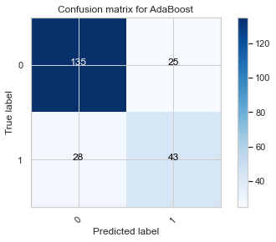
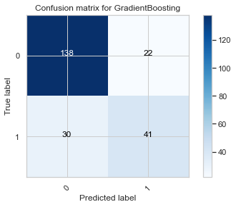
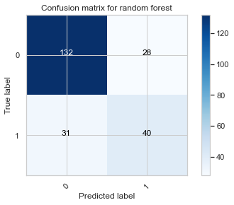
RESULT
A confusion matrix was plotted and analyzed. The confusion matrix showed that the Gradient Boosting Classifier would be the best choice for us to proceed with our analysis.

Slide 18
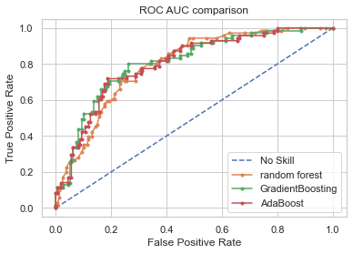
RESULT
ROC AUC comparison was plotted with no skill (baseline), Random Forrest, Gradient Boosting, and Ada Boost. The result of the plot shows that all three models perform very similiarly, but the Gradient Boosting would be the best predictive model.

Slide 19
RESULT
Two features were found to have the most importance; Glucose and BMI. We plotted the accuracy of the Gradient Boosting Classifier in reduced feature space to be 75%, with Glucose absolute coefficient being 0.62, and BMI 0.37.

Slide 20
Discussion
The model evaluated in this study shows how data mining techniques via machine learning predictive modelling can be used to predict human disease.
Our results show how machine learning and classification algorithms can be used to predict diabetes.
The two features that were found to be most important were BMI and glucose.

Slide 21
Discussion
For BMI, there is a certain relationship between the satisfaction rate of blood glucose control and overweight or obesity, which explains the importance of BMI in the classification of control satisfaction.
This tells us that lifestyle choices can make a difference between whether you develop diabetes or not.

Slide 22
Discussion
The results show that there are many predictive models that can be applied, but only certain models will work best which is very dependent on the selected dataset.
Therefore, when focusing on a certain disease, several appropriate classification algorithms should be selected based on the characteristics of the dataset.
By comparing the classification accuracy of many classification algorithms on the dataset, the most effective classification algorithm can be selected and used as the diagnostic model.

Slide 23
Discussion
In general, the performance of machine learning algorithms is evaluated using predictive accuracy.
In addition, despite the claims that machine learning classification algorithms can generate sufficient and effective decision-making, very few have really permeated the clinical practice.
Therefore, the practice of using machine learning algorithms to predict disease should be under further study in the biomedical research and development field, and we hope that this study provided a good example of how this can be done.

Slide 24
Future Work
One of the most important real-world medical problems is the detection of diabetes at its early stage.
In this study, systematic efforts are made in finding a system which results in the prediction of diabetes through data science via predictive modelling algorithms.
Though this work may not be the final solution to the prediction of diabetes, it serves as an example of the power data science may have on the prediction of other diseases as well.

Slide 25
Future Work
During this work, three machine learning classification algorithms are chosen and evaluated on various measures.
The results determine the adequacy of the system with an achieved accuracy of 79% using the Random Forrest classification algorithm.
In the future, this system with the use of machine learning classification algorithms may be able to be used to predict or diagnose other diseases as well. The work therefor be extended and improved for the automation of diabetes analysis using the methods described here as well as other machine learning algorithms.

Slide 26
References
Huang, R. (2021). Prediction of Pima Indians Diabetes with Machine Learning Algorithms. UCLA. ProQuest ID: Huang_ucla_0031N_19508. Merritt ID: ark:/13030/m5md4q60. Retrieved from https://escholarship.org/uc/item/6rh07945
Altıntaş, Ergin. “UCI Diabetes Data Set.” Kaggle, 1 May 2020, www.kaggle.com/ealtintas/uci-machine-learning-repository-diabetes-data-set.
World Health Organization (WHO). “Diabetes.” Kaggle, 2 April 2021, https://www.who.int/health-topics/diabetes#tab=tab_1.

